Slide 1
STAT3013 Project
Childhood Brain Cancer in Florida: A Bayesian Clustering Approach

Slide 2
Scientific Question
The scientific question is:
To check the robustness of the findings of another publication that there exists “putative clusters of pediatric brain cancer at zip code aggregation level in the U.S. state of Florida” and, “in particular, the raised incidence of pediatric brain cancer was found in the southern area of the state (south Florida cluster)”.

Slide 3
Motivation

Slide 4
The data
The data was taken from the Florida Association of Paediatric Tumour Programs.
The structure of the data is the relative risk of cancer, split up into zip code areas

Slide 5
The models
The article tested 3 different models to see which described the structure of the data better.
These are:
The Standarised morbidity ratio (SMR)(i.e the MLE)
The Besag, York, and Mollie model (BYM)
The Sparse Poisson Convolution (SPC)

Slide 6
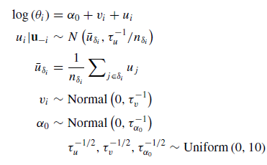
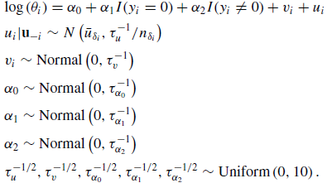
The models
The BYM Model
The SPC Model

Slide 7
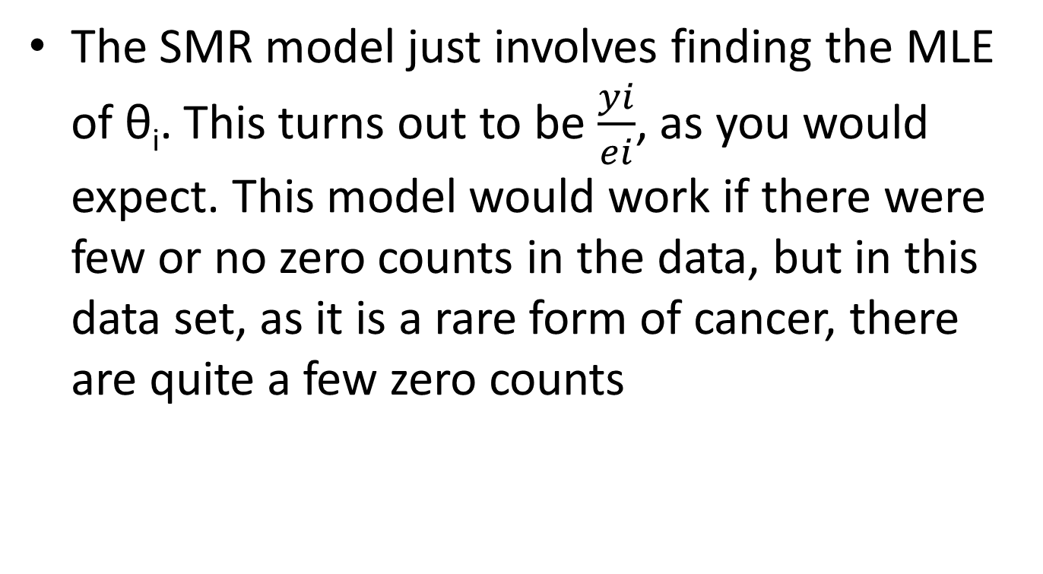
The SMR Model
The SMR model just involves finding the MLE of θ_{i}. This turns out to be $\frac{yi}{ei}$, as you would expect. This model would work if there were few or no zero counts in the data, but in this data set, as it is a rare form of cancer, there are quite a few zero counts

Slide 8
The BYM Model

Slide 9
The SPC Model
The SPC model is the BYM model with an indicator variable added in for whether the data value is zero or not. They have included this in the model, as zero counts in the data can be a problem since they are modelling it with a poisson distribution.

Slide 10
Model Checking

Slide 11
Results of the article

Slide 12
Extension

Slide 13
Extension

Slide 14
Extension

Slide 15
Extension

Slide 16
Extension

Slide 17
Extension

Slide 18
Extension

Slide 19
Summary

